Slide 1

RELATIONS, FUNCTIONS AND GRAPHS

Slide 2
RELATIONS AND FUNCTIONS
Relation
is referred to as any set of ordered pair.
conventionally, It is represented by the ordered pair ( x , y ).
x is called the first element or x-coordinate while y is the second element or y-coordinate of the ordered pair.

Slide 3
FUNCTION
a set of ordered pairs in which no two ordered pairs have the same first coordinate and different second coordinates
every function is a relation, not every relation is a function
it may have ordered pairs with the same second coordinate

Slide 4
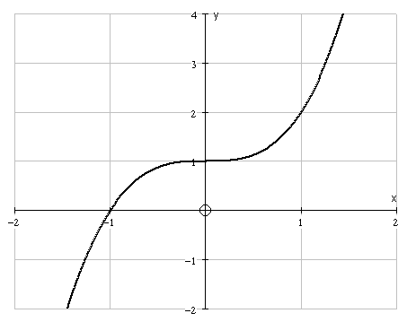
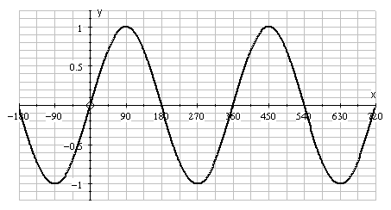
ONE-TO-ONE AND MANY-TO-ONE FUNCTIONS
Consider the following graphs
and
Each value of x maps to only one value of y . . .
Each value of x maps to only one value of y . . .
and each y is mapped from only one x.
BUT many other x values map to that y.

Slide 5
Consider the following graphs
and
is an example of a many-to-one function
is an example of a one-to-one function
One-to-many is NOT a function. It is just a relation. Thus a function is a relation but a relation sometimes cannot be a function.

Slide 6
DOMAIN AND RANGE
Domain
is the set of all the first coordinates of the ordered pair
Independent Variable
is the variable that represents elements of the domain

Slide 7
RANGE
Is the set of all the second coordinates
Dependent Variable
Is the variable that represents elements of the range

Slide 8
X | 1st element | abscissa | Independent variable | domain
y | 2nd element | ordinate | Dependent variable | range

Slide 9
EXAMPLE
Determine the domain and range of the following equations,
State whether it is a function or a relation, and
Sketch the graph of each.
Given:

Slide 10
State whether the relation defines y as a function of x.
1.
2.

Slide 11
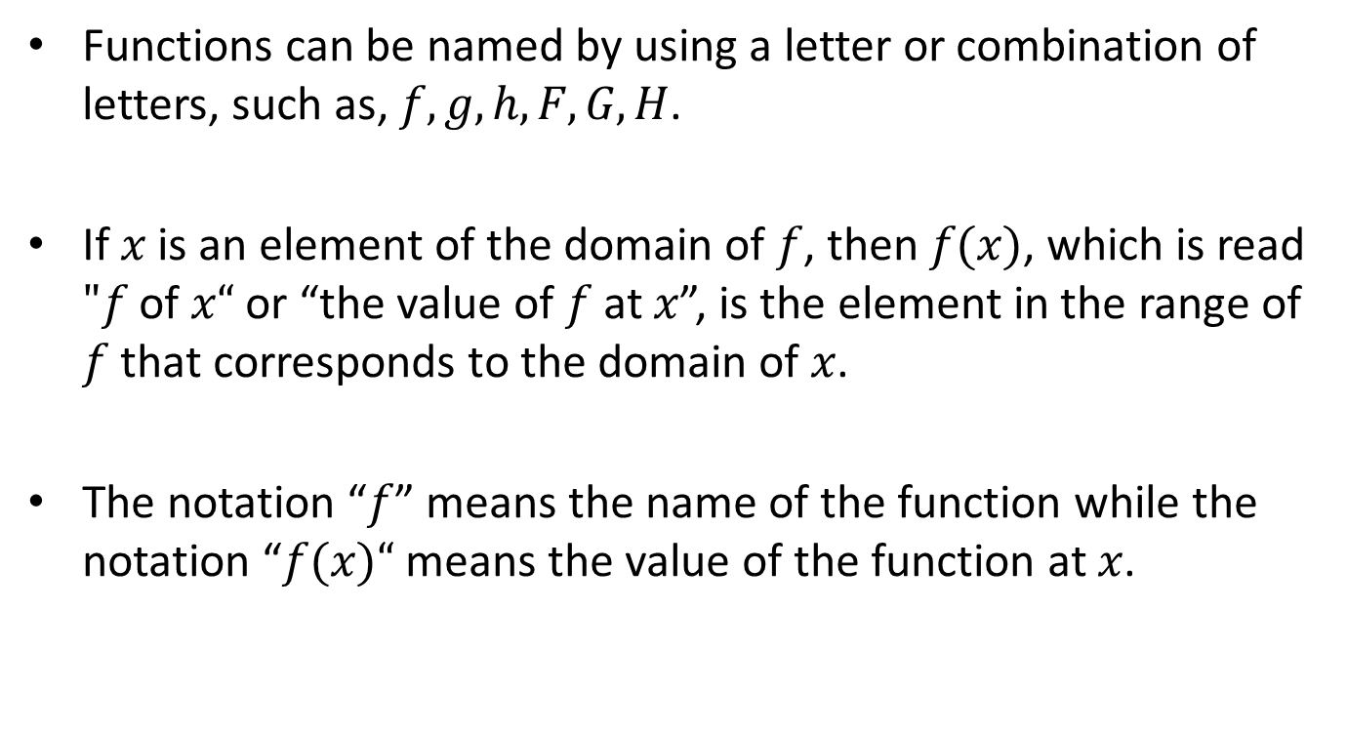
FUNCTION NOTATION
Functions can be named by using a letter or combination of letters, such as, $f, g, h, F, G, H$.
If $x$ is an element of the domain of $f$, then $f(x)$, which is read $"f$ of $x“$ or “the value of $f$ at $x$”, is the element in the range of $f$ that corresponds to the domain of $x$.
The notation “$f$” means the name of the function while the notation “$f(x)“$ means the value of the function at $x$.

Slide 12
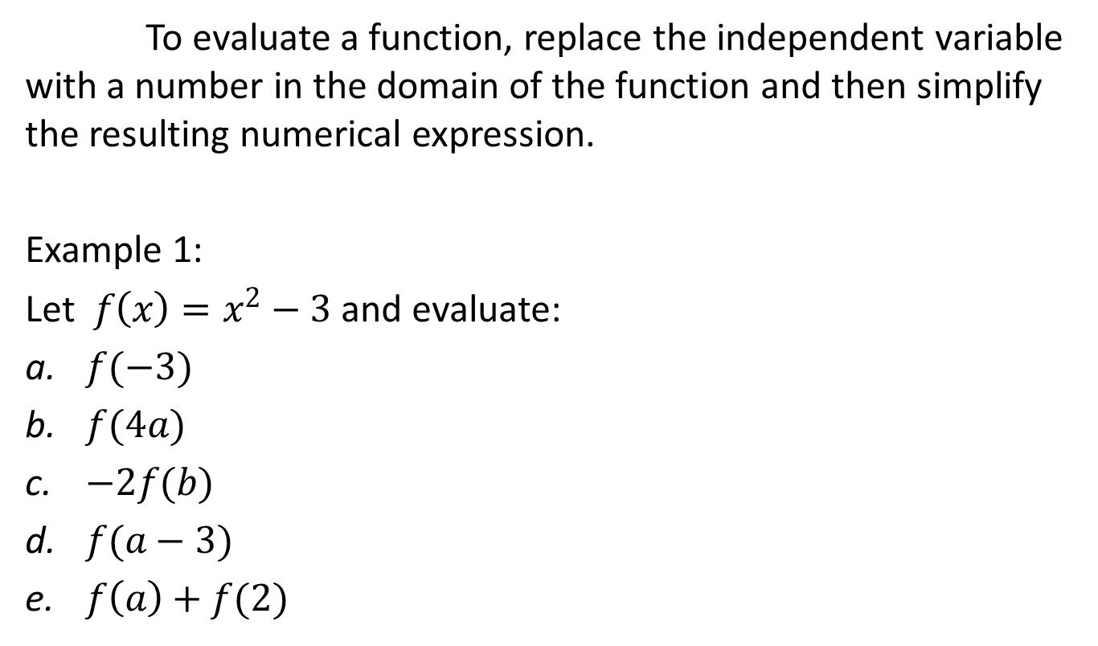
EVALUATION OF FUNCTIONS
To evaluate a function, replace the independent variable with a number in the domain of the function and then simplify the resulting numerical expression.
Example 1:
Let $f\left(x\right)=x^{2}−3$ and evaluate:
$f(−3)$
$f(4a)$
$−2f(b)$
$f(a−3)$
$f\left(a\right)+f(2)$

Slide 13

Example 2:
Let $A\left(x\right)=\sqrt{x^{2}−4}$, find
$A(−2)$
$A(4)$
$A(w+1)$
Example 3:
Let $G\left(x\right)=\frac{\left|x\right|}{x}$, find
$G(−1)$
$G(2)$
$G\left(a\right), a>0$
$G\left(a\right), a<0$

Slide 14
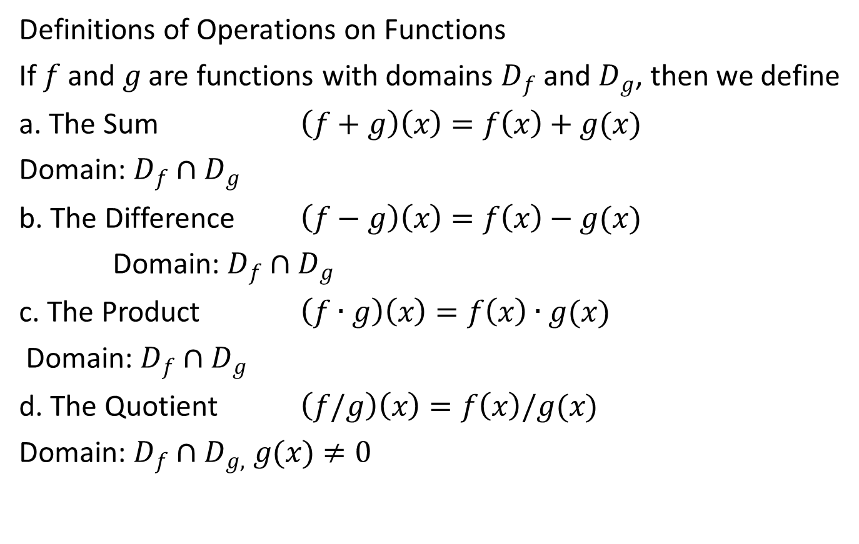
ALGEBRA OF FUNCTIONS
Definitions of Operations on Functions
If $f$ and $g$ are functions with domains $D_{f}$ and $D_{g}$, then we define
a. The Sum $\left(f+g\right)\left(x\right)=f\left(x\right)+g(x)$
Domain: $D_{f}∩D_{g}$
b. The Difference $\left(f−g\right)\left(x\right)=f\left(x\right)−g(x)$
Domain: $D_{f}∩D_{g}$
c. The Product $\left(f∙g\right)\left(x\right)=f\left(x\right)∙g(x)$
Domain: $D_{f}∩D_{g}$
d. The Quotient $\left(f/g\right)\left(x\right)=f\left(x\right)/g(x)$
Domain: $D_{f}∩D_{g,} g(x)≠0$

Slide 15
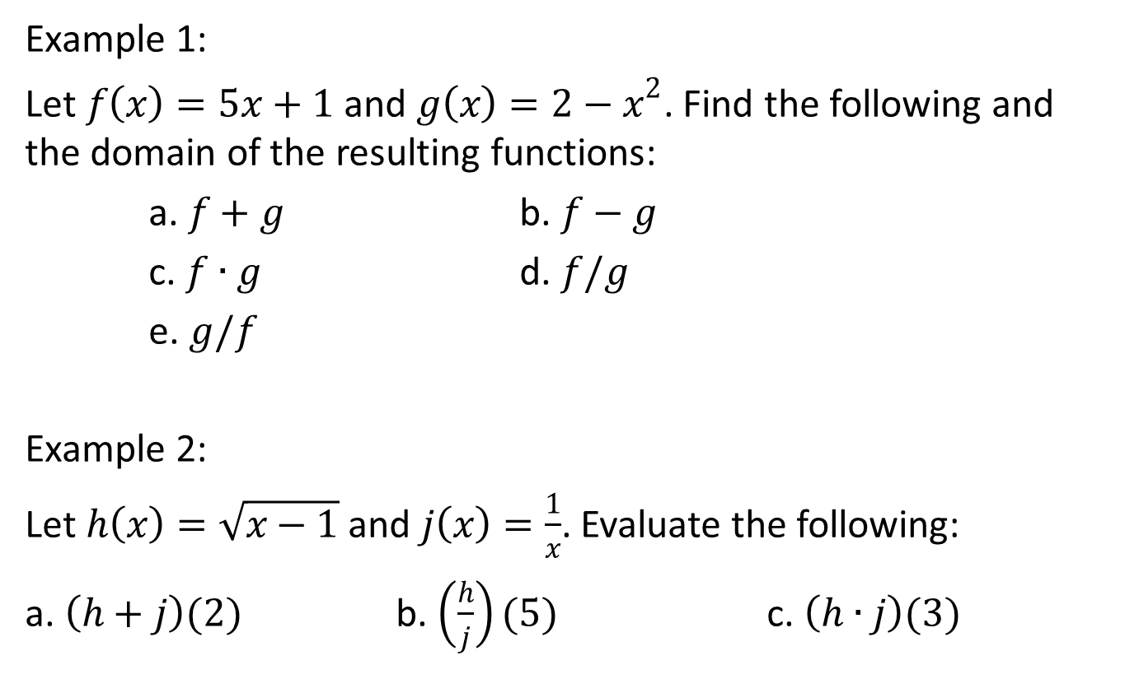
Example 1:
Let $f\left(x\right)=5x+1$ and $g\left(x\right)={2−x}^{2}$. Find the following and the domain of the resulting functions:
a. $f+g$ b. $f−g$
c. $f∙g$ d. $f/g$
e. $g/f$
Example 2:
Let $h\left(x\right)=\sqrt{x−1}$ and $j\left(x\right)=\frac{1}{x}$. Evaluate the following:
a. $\left(h+j\right)(2)$ b. $\left(\frac{h}{j}\right)(5)$ c. $\left(h∙j\right)(3)$

Slide 16
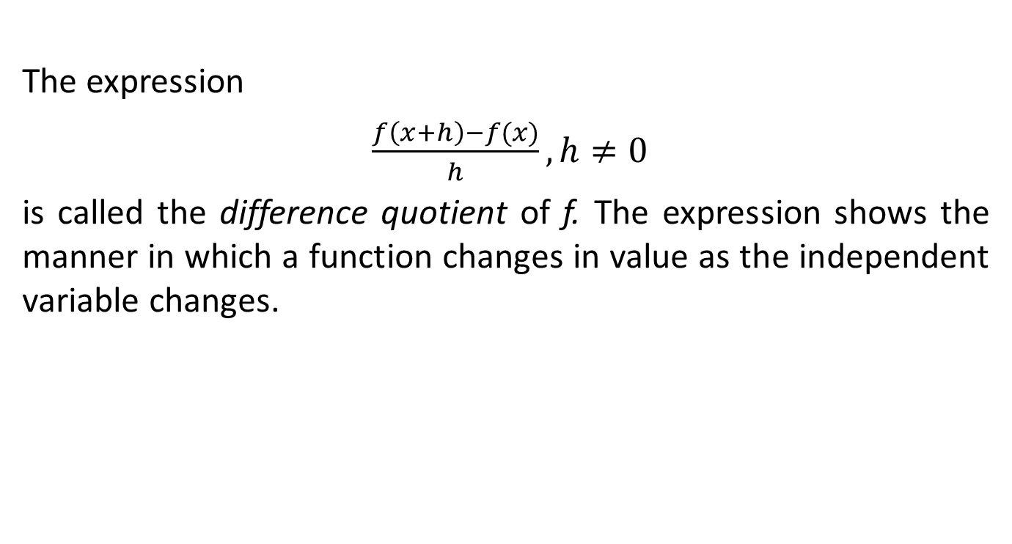
DIFFERENCE QUOTIENT
The expression
$$\frac{f\left(x+h\right)−f(x)}{h}, h≠0$$
is called the difference quotient of f. The expression shows the manner in which a function changes in value as the independent variable changes.

Slide 17
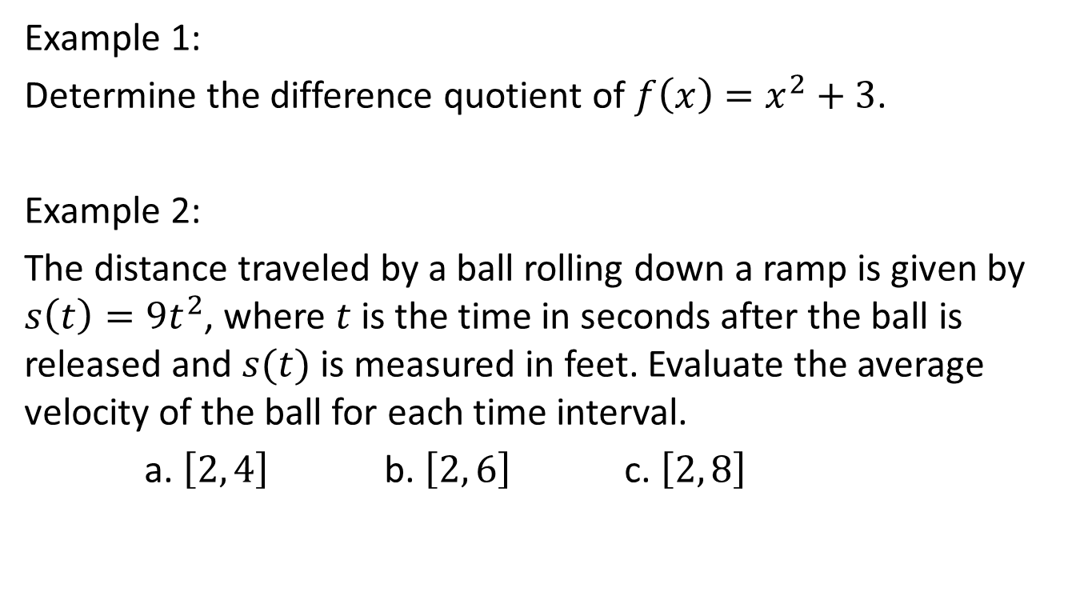
Example 1:
Determine the difference quotient of $f\left(x\right)=x^{2}+3$.
Example 2:
The distance traveled by a ball rolling down a ramp is given by $s\left(t\right)={9t}^{2}$, where $t$ is the time in seconds after the ball is released and $s(t)$ is measured in feet. Evaluate the average velocity of the ball for each time interval.
a. $\left[2, 4\right]$ b. $\left[2, 6\right]$ c. $\left[2, 8\right]$

Slide 18
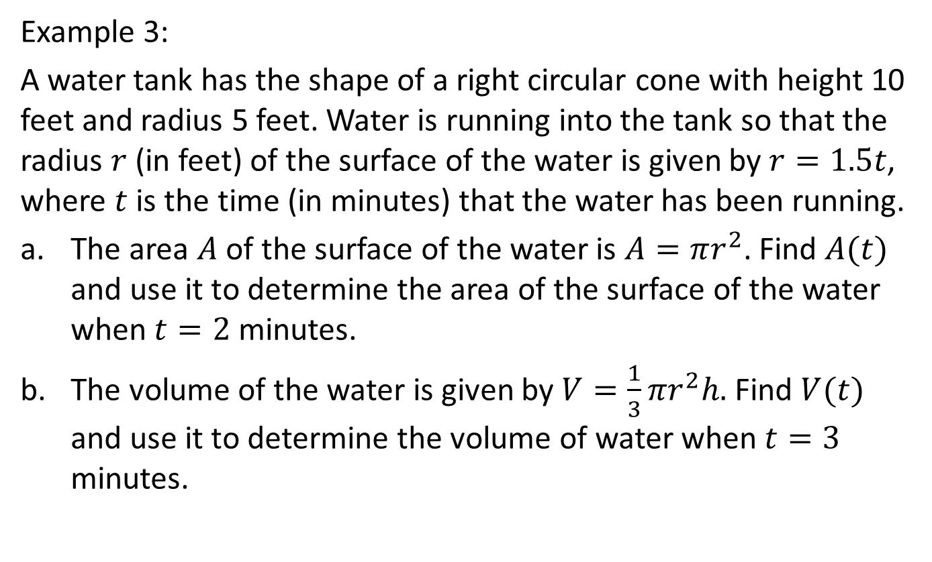
Example 3:
A water tank has the shape of a right circular cone with height 10 feet and radius 5 feet. Water is running into the tank so that the radius $r$ (in feet) of the surface of the water is given by $r=1.5t$, where $t$ is the time (in minutes) that the water has been running.
The area $A$ of the surface of the water is $A=πr^{2}$. Find $A(t)$ and use it to determine the area of the surface of the water when $t=2$ minutes.
The volume of the water is given by $V=\frac{1}{3}πr^{2}h.$ Find $V(t)$ and use it to determine the volume of water when $t=3$ minutes.

Slide 19
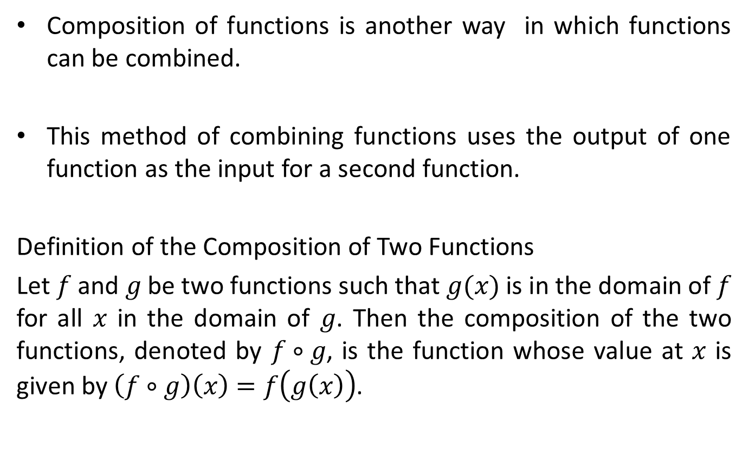
COMPOSITION OF FUNCTIONS
Composition of functions is another way in which functions can be combined.
This method of combining functions uses the output of one function as the input for a second function.
Definition of the Composition of Two Functions
Let $f$ and $g$ be two functions such that $g(x)$ is in the domain of $f$ for all $x$ in the domain of $g$. Then the composition of the two functions, denoted by $f∘g$, is the function whose value at $x$ is given by $\left(f∘g\right)\left(x\right)=f\left(g\left(x\right)\right)$.

Slide 20
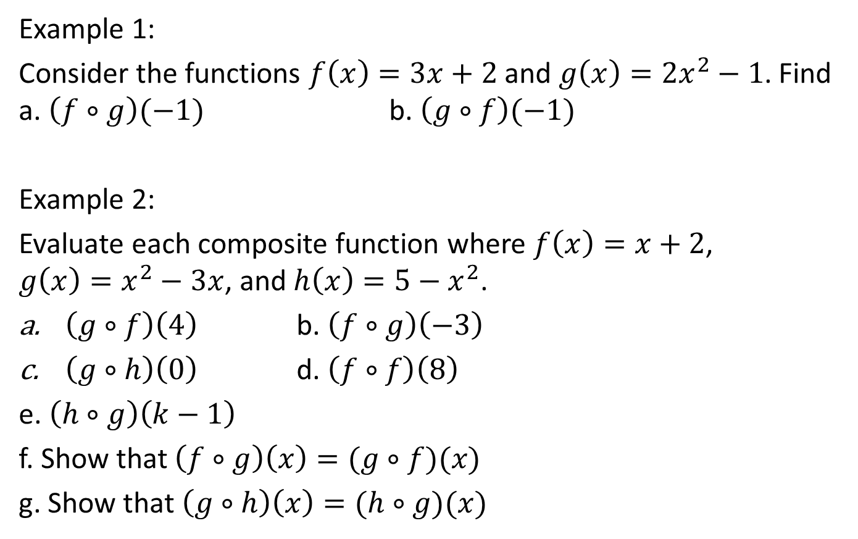
Example 1:
Consider the functions $f\left(x\right)=3x+2$ and $g\left(x\right)={2x}^{2}−1$. Find a. $\left(f∘g\right)(−1)$ b. $\left(g∘f\right)(−1)$
Example 2:
Evaluate each composite function where $f\left(x\right)=x+2$, $g\left(x\right)=x^{2}−3x$, and $h\left(x\right)=5−x^{2}$.
$\left(g∘f\right)\left(4\right)$ b. $\left(f∘g\right)\left(−3\right)$
$\left(g∘h\right)\left(0\right)$ d. $\left(f∘f\right)\left(8\right)$
e. $\left(h∘g\right)\left(k−1\right)$
f. Show that $\left(f∘g\right)\left(x\right)=(g∘f)(x)$
g. Show that $\left(g∘h\right)\left(x\right)=(h∘g)(x)$

Slide 21

PIECEWISE – DEFINED FUNCTIONS
These are functions represented by more than one expression.
Example:
$$f\left(x\right)=\left\{\begin{matrix}x−1, x<−3 \\ x^{2}−1, −3≤x≤4 \\ 5−x, x>4\end{matrix}\right.$$

Slide 22
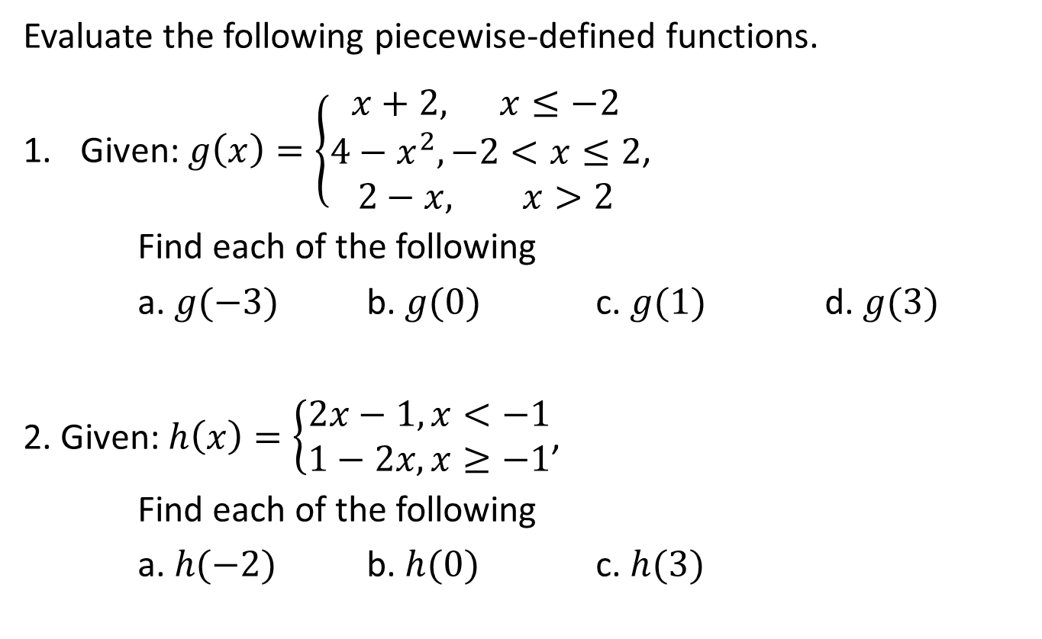
Evaluate the following piecewise-defined functions.
Given: $g\left(x\right)=\left\{\begin{matrix}x+2, x≤−2 \\ 4−x^{2}, −2<x≤2 \\ 2−x, x>2\end{matrix}\right.$,
Find each of the following
a. $g(−3)$ b. $g(0)$ c. $g(1)$ d. $g(3)$
2. Given: $h\left(x\right)=\left\{\begin{matrix}2x−1, x<−1 \\ 1−2x, x≥−1\end{matrix}\right.$,
Find each of the following
a. $h(−2)$ b. $h(0)$ c. $h(3)$

Slide 23
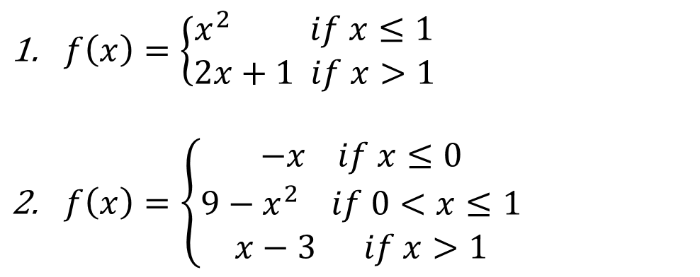
The graph of a piecewise function consists of separate functions.
Example: Graph each piecewise function.
$f\left(x\right)=\left\{\begin{matrix}x^{2} if x≤1 \\ 2x+1 if x>1\end{matrix}\right.$
$f\left(x\right)=\left\{\begin{matrix}−x if x≤0 \\ 9−x^{2} if 0<x≤1 \\ x−3 if x>1\end{matrix}\right.$

Slide 24
GREATEST INTEGER FUNCTION (FLOOR FUNCTION)
The graphs of some functions do not have any breaks or gaps. These functions, whose graphs can be drawn without lifting a pencil off the paper, are called continuous functions.
The graphs of other functions do have breaks or discontinuities. One such function is the greatest integer function or floor function. This function is denoted by symbols such as and int(x).
The value of the greatest integer function at x is the greatest integer that is less than or equal to x.

Slide 25
For instance,
To graph the floor function, first observe that the value of the floor function is constant between any two consecutive integers.
For instance, between the integers 1 and 2, we have
int(1.1) = 1 int(1.35) = 1 int(1.872) = 1 int(1.999) = 1
Between –3 and –2 we have
int(–2.98) = –3 int(–2.4) = –3 int(–2.35) = – 3 int(–2.01) = –3

Slide 26
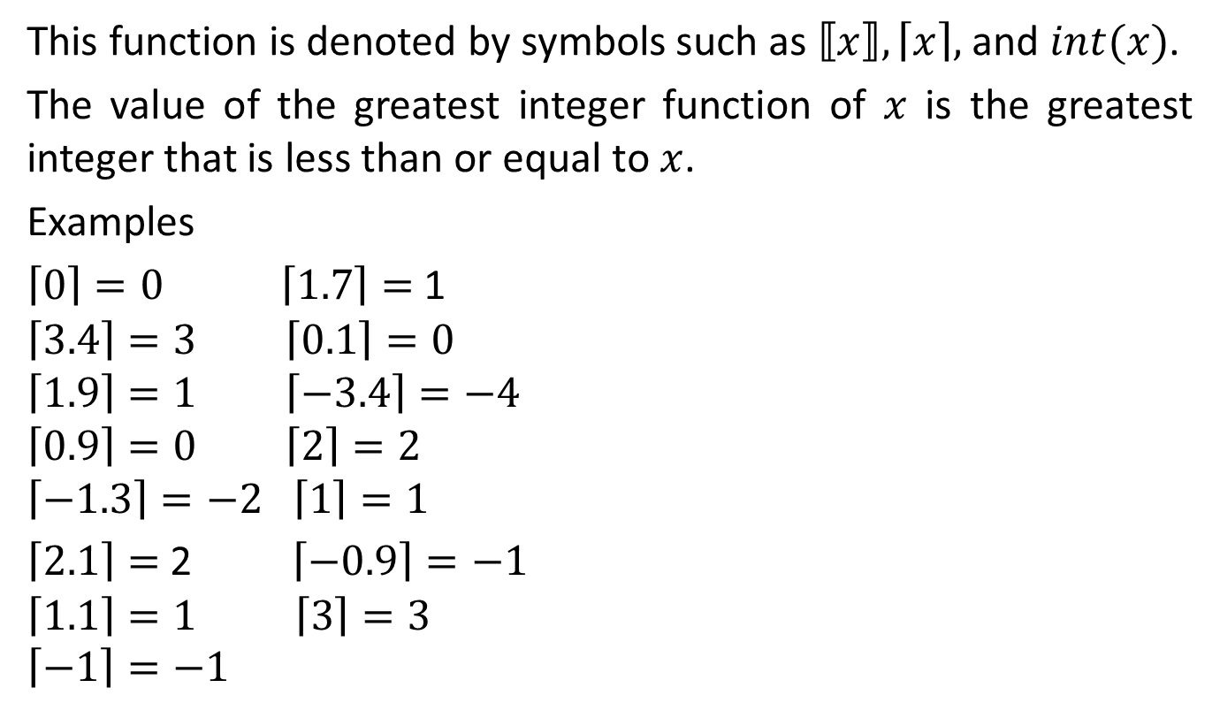
This function is denoted by symbols such as $⟦x⟧, \left\lceil x\right\rceil ,$ and $int(x)$.
The value of the greatest integer function of $x$ is the greatest integer that is less than or equal to $x$.
Examples
$\left\lceil 0\right\rceil =0 \left\lceil 1.7\right\rceil =$ 1
$$\left\lceil 3.4\right\rceil =3 \left\lceil 0.1\right\rceil =0$$
$$\left\lceil 1.9\right\rceil =1 \left\lceil −3.4\right\rceil =−4$$
$$\left\lceil 0.9\right\rceil =0 \left\lceil 2\right\rceil =2$$
$$\left\lceil −1.3\right\rceil =−2 \left\lceil 1\right\rceil =1$$
$\left\lceil 2.1\right\rceil =$ 2 $\left\lceil −0.9\right\rceil =−1$
$$\left\lceil 1.1\right\rceil =1 \left\lceil 3\right\rceil =3$$
$$\left\lceil −1\right\rceil =−1$$

Slide 27
GREATEST INTEGER FUNCTION (FLOOR FUNCTION)
Using the property of the floor function, we can create a table of values and then graph the floor function.

Slide 28
The graph of the floor function has discontinuities (breaks) whenever x is an integer.
The domain of the floor function is the set of real numbers; the range is the set of integers.
Because the graph appears to be a series of steps, sometimes the floor function is referred to as a step function.

Slide 29
One application of the floor function is rounding numbers. For instance, suppose a credit card company charges 1.5% interest on an unpaid monthly balance of $237.84.
Then the interest charge I is
I = 237.84  0.015 = 3.5676
Thus the interest charge is $3.57.
Note that the result was rounded to the nearest cent, or hundredth.

Slide 30
The computer program that determines the interest charge uses the floor function to calculate the rounding.
To round a number N to the nearest kth decimal place, we use the following formula.
Here is the calculation for the interest owed.

Slide 31
In this case, N = 237.84  0.015 and k = 2 (round to the second decimal place).

Slide 32
EXAMPLE Use the Greatest Integer Function to Model Expenses
The cost of parking in a garage is $3 for the first hour or any part of the first hour and $2 for each additional hour or any part of an hour thereafter. If x is the time in hours that you park your car, then the cost is given by
C(x) = 3 – 2 int(1 – x), x > 0
a. Evaluate C(2) and C(2.5).
b. Graph y = C(x) for 0 < x ≤ 5.

Slide 33
SOLUTION
C(2) = 3 – 2 int(1 – 2)
= 3 – 2 int(–1)
= 3 – 2(–1)
= $5
C(2.5) = 3 – 2 int(1 – 2.5)
= 3 – 2 int(–1.5)
= 3 – 2(–2)
= $7

Slide 34
SOLUTION
cont’d
To graph C(x) for 0 < x ≤ 5, consider the value of int(1 – x) for each of the intervals 0 < x ≤ 1, 1< x ≤ 2, 2 < x ≤ 3, 3 < x ≤ 4, and 4 < x ≤ 5.
For instance, when 0 < x ≤ 1, 0 ≤ 1 – x < 1.
Thus int(1 – x) = 0 when 0 < x ≤ 1.
Now consider 1< x ≤ 2. When 1< x ≤ 2 , –1≤ 1 – x < 0.
Thus int(1 – x) = –1 when 1< x ≤ 2.

Slide 35
SOLUTION
cont’d
Applying the same reasoning to each of the other intervals gives the following table of values and the graph of C shown in the figure

Slide 36
SOLUTION
cont’d
Because C(1) = 3, C(2) = 5, C(3) = 7, C(4) = 9, and
C(5) = 11, we can use a solid circle at the right endpoint of
each “step” and an open circle at each left endpoint.

Slide 37
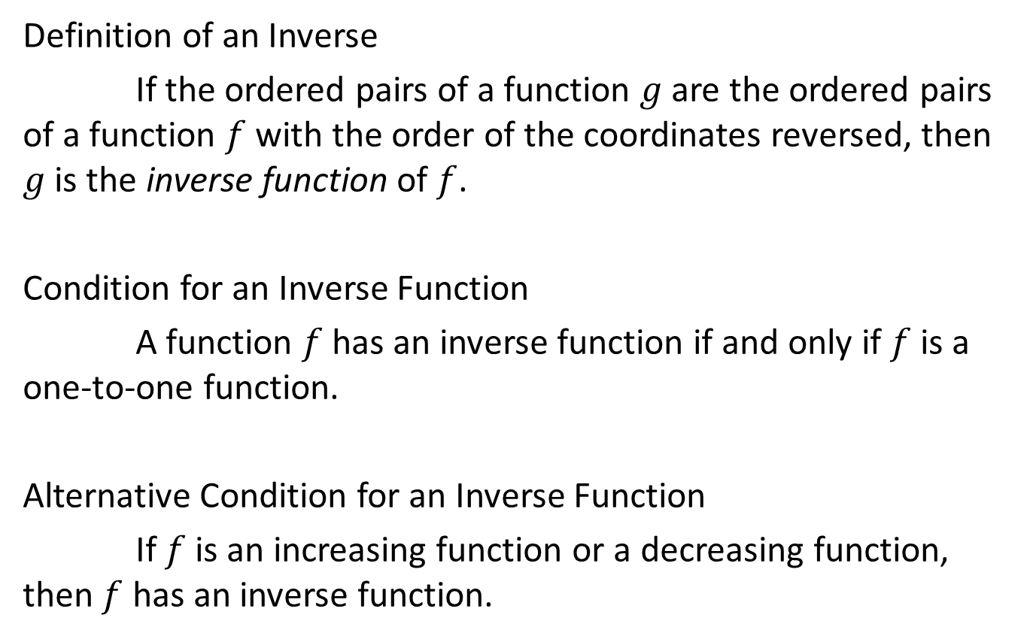
INVERSE FUNCTIONS
Definition of an Inverse
If the ordered pairs of a function $g$ are the ordered pairs of a function $f$ with the order of the coordinates reversed, then $g$ is the inverse function of $f$.
Condition for an Inverse Function
A function $f$ has an inverse function if and only if $f$ is a one-to-one function.
Alternative Condition for an Inverse Function
If $f$ is an increasing function or a decreasing function, then $f$ has an inverse function.

Slide 38
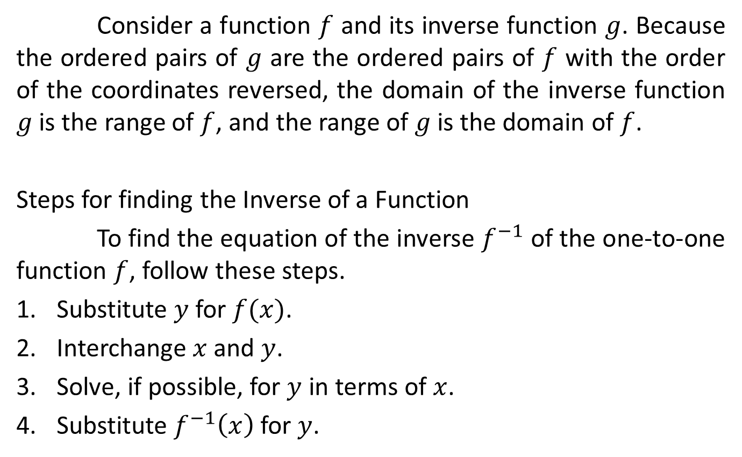
Consider a function $f$ and its inverse function $g$. Because the ordered pairs of $g$ are the ordered pairs of $f$ with the order of the coordinates reversed, the domain of the inverse function $g$ is the range of $f$, and the range of $g$ is the domain of $f$.
Steps for finding the Inverse of a Function
To find the equation of the inverse $f^{−1}$ of the one-to-one function $f$, follow these steps.
Substitute $y$ for $f(x)$.
Interchange $x$ and $y$.
Solve, if possible, for $y$ in terms of $x$.
Substitute $f^{−1}\left(x\right)$ for $y$.

Slide 39
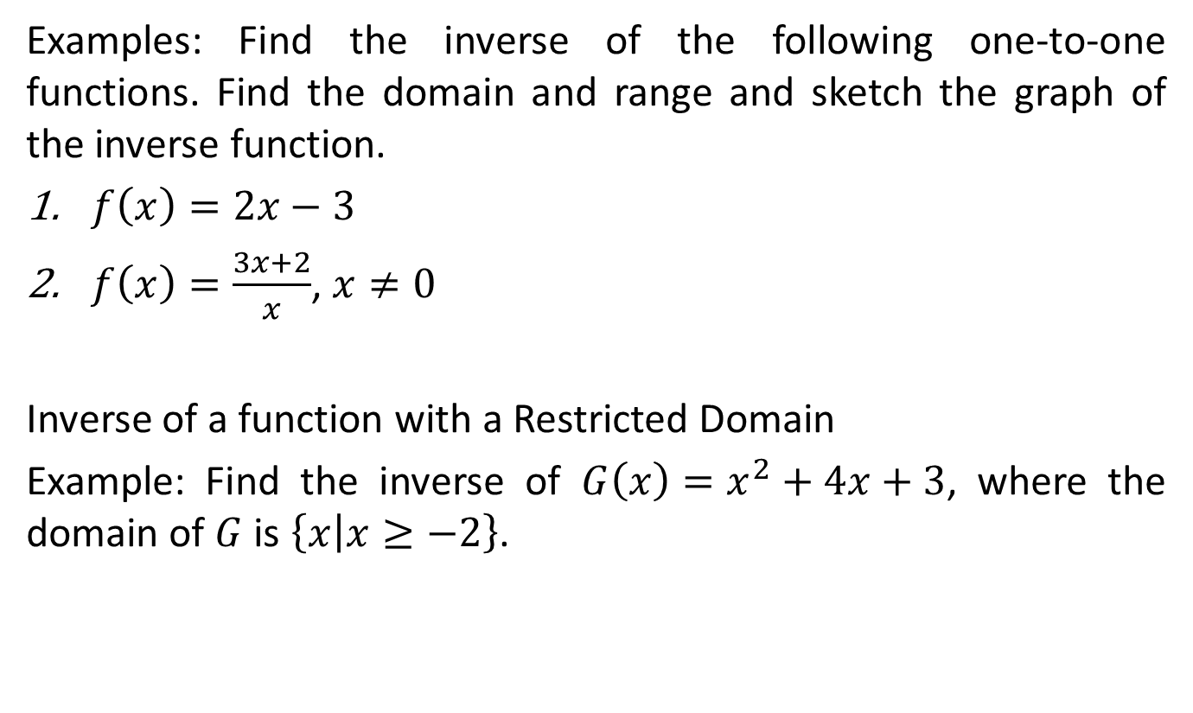
Examples: Find the inverse of the following one-to-one functions. Find the domain and range and sketch the graph of the inverse function.
$f\left(x\right)=2x−3$
$f\left(x\right)=\frac{3x+2}{x}$, $x≠0$
Inverse of a function with a Restricted Domain
Example: Find the inverse of $G\left(x\right)=x^{2}+4x+3$, where the domain of $G$ is $\left\{x | x≥−2\right\}$.

